Slide 1
Lesson 30
Technology and Society
Computer Literacy BASICS: A Comprehensive Guide to IC³, 4th Edition
Morrison / Wells

Slide 2
Objectives
Use computers at work, school, and home.
Use computer technology in everyday life.
Use technology to transform traditional processes.
Identify assistive technologies.
2
2

Slide 3
Vocabulary
business-to-business (B2B)
business-to-consumer (B2C)
business-to-government (B2G)
critical thinking
digital cash
electronic commerce (e-commerce)
keyless entry system
online learning
telecommuting
3
3

Slide 4
Using Computers at Work, School, and Home
Technology today is integrated into almost every facet of life and influences how you work, use computers at home, and learn about the world outside your doors.
Collecting Information:
Using the Internet is a fast and easy way to find the information you need.
Organizing Information:
You can use databases and spreadsheets to arrange and calculate data in a variety of ways.
4
4

Slide 5
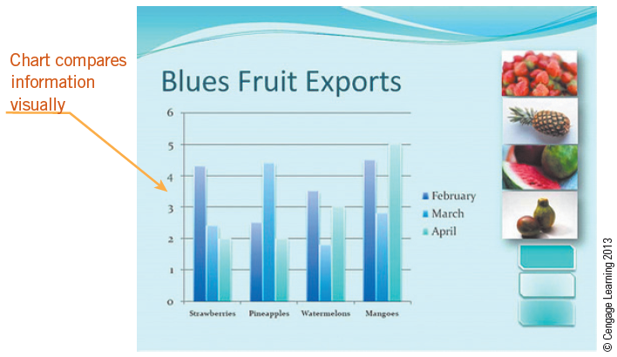
Using Computers at Work, School, and Home (continued)
Evaluating Information:
You can use spreadsheets to ask what-if questions and evaluate information.
Arranging data in tables, charts, and lists helps you see patterns or trends in the data and evaluate it by comparing one set of calculated results to another.
5
5

Slide 6
Using Computers at Work, School, and Home (continued)
Communicating Information:
Technology provides communication options such as e-mail, instant messaging, blogs, and social Web sites such as Facebook and Twitter.
Increasing Productivity:
Access to the Internet can increase your productivity by providing online access to multiple resources.
6
6

Slide 7
Using Computers at Work, School, and Home (continued)
Collaborating with Others and Solving Problems:
You can take advantage of Web services to supplement project-based learning.
One type of online collaboration is crowdsourcing, which combines the collective effort of many people to complete a task.
7
7

Slide 8
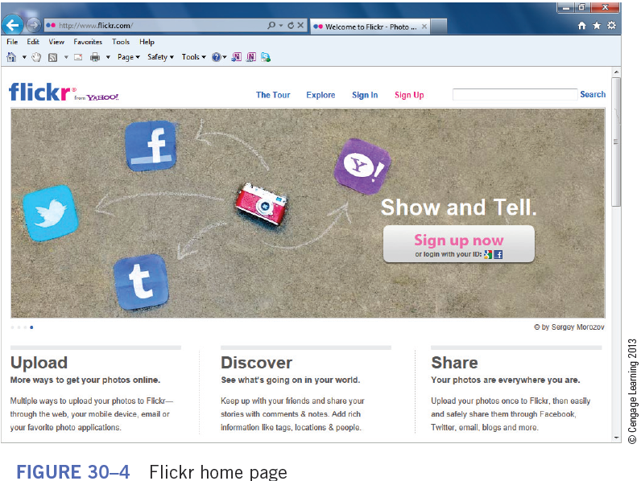
Using Computers at Work, School, and Home (continued)
Creating Communities:
Online communities and social networking sites provide an opportunity to socialize with others who have common interests.
8
8

Slide 9
Using Computers at Work, School, and Home (continued)
Facilitating Learning:
You can use the Internet as a resource for learning and discovering new facts and information.
Many textbooks published today have an associated Web site where students can access Web-based projects, find study aides to accompany the text, and do homework.
9
9

Slide 10
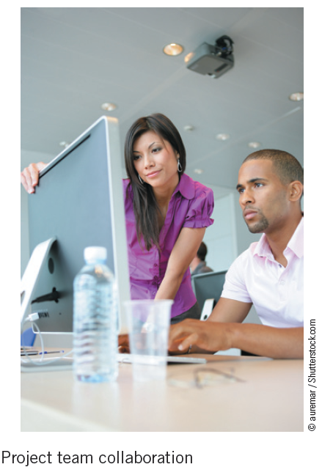
Using Computers at Work, School, and Home (continued)
Promoting Creativity:
Modern technology provides tools you can use to create a range of artistic work that can be published for a real audience anywhere in the world.
10
10

Slide 11
Using Computers at Work, School, and Home (continued)
Supporting Critical Thinking:
When searching for information on the Internet, you need to use critical thinking.
Critical thinking can mean “consisting of a mental process of analyzing or evaluating information,” “the process of evaluating propositions or hypotheses and making judgments,” or “showing or requiring careful analysis before judgment.”
11
11

Slide 12
Using Computers at Work, School, and Home (continued)
Facilitating Daily Life:
Electronic commerce, or e-commerce, means conducting business of the Internet.
You can access electronic catalogs, select goods, store them in a digital cart or bag, and then check out by paying with a credit card or online account.
12
12

Slide 13
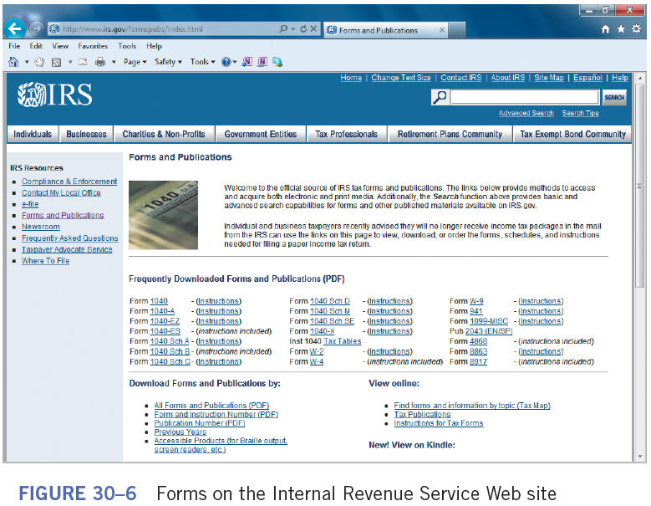
Using Computers at Work, School, and Home (continued)
Facilitating Daily Life (continued):
Local, state, and national government Web sites provide access to many services.
13
13

Slide 14
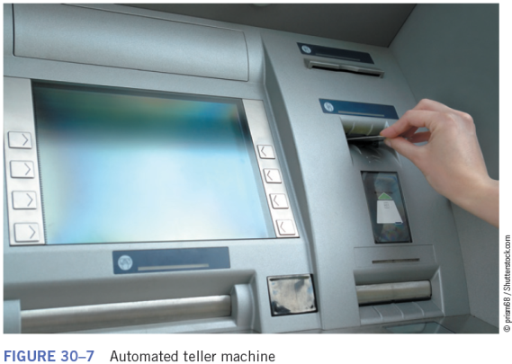
Using Computer Technology in Everyday Life
Using desktop and laptop computers represents only a fraction of your interactions with computer technology.
Automated Teller Machines:
ATMs allow you to do your banking almost anywhere, anytime.
Electronic checks and debit
cards are making cash more
obsolete every day.
14
14

Slide 15
Using Computer Technology in Everyday Life (continued)
Credit Card and Other Commerce Systems:
Many people no longer carry large sums of money while traveling. They prefer to use ATM or credit cards.
If you lose a credit card or an ATM card, it can be canceled immediately, whereas if your money is lost or stolen, the chances of recovery are very small.
A security concern on the Internet is the theft of credit card information stored electronically.
15
15

Slide 16
Using Computer Technology in Everyday Life (continued)
Automated Industrial Processes:
The use of computerized robots on assembly lines and in other industrial processes has expanded production capabilities in the manufacturing world.
Performance is precise, measurements are exact, and production is increase.
16
16

Slide 17
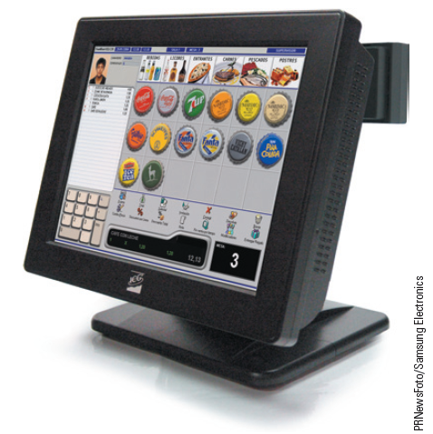
Using Computer Technology in Everyday Life (continued)
Point-of-Sale Systems:
A terminal used for electronic processing of payment transactions in a retail outlet is called a point-of-sale (POS) system.
Many of the POS systems include a complete accounting, inventory, and management system.
17
17

Slide 18
Using Computer Technology in Everyday Life (continued)
Weather Predicting and Reporting Systems:
Numerical weather-prediction programs are used by most professional meteorologists.
Global Positioning Systems:
A global positioning system (GPS), combined with cell phone technology, can provide location information and directions.
18
18

Slide 19
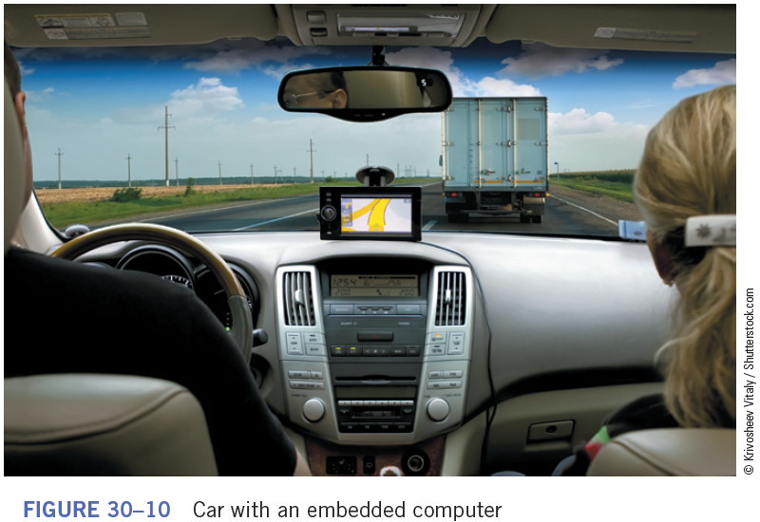
Using Computer Technology in Everyday Life (continued)
Embedded Computers in Appliances and Equipment:
An embedded computer is designed to perform one or a few dedicated tasks within a device or appliance.
19
19

Slide 20
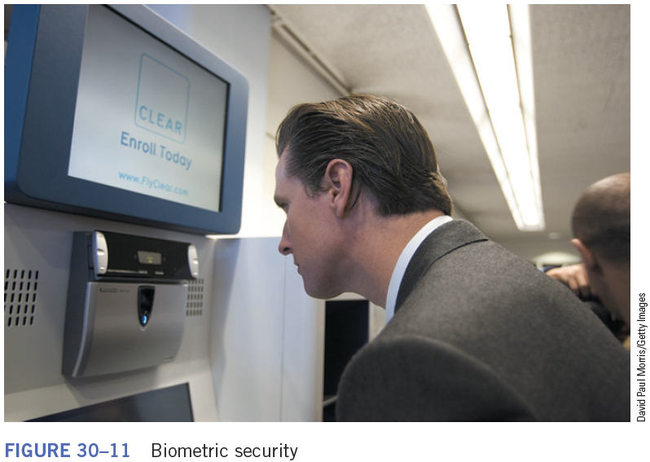
Using Computer Technology in Everyday Life (continued)
Security Systems:
Keyless entry systems are available for cars, entrance doors to houses, business, and other buildings.
Some security systems require more sophisticated user identification, such as biometrics.
20
20

Slide 21
Using Technology to Transform Traditional Processes
E-Commerce:
E-commerce, which means having an online business, is changing the way the world does business.
Out of the thousands of online companies, most are smaller businesses.
The digital cash system allows you to pay by transmitting a number from one computer to another.
When you use digital cash, no one can obtain information about you.
21
21

Slide 22
Using Technology to Transform Traditional Processes (continued)
Business Connections:
Business-to-business (B2B) describes e-commerce transactions between businesses, such as between a company and a supplier.
Business-to-consumer (B2C) describes online transactions between businesses and consumers.
A third category is business-to-government (B2G).
Radio-frequency identification (RFID) tags are small electronic devices that identify and track goods from point of delivery to point of sale, similar to a bar code.
22
22

Slide 23
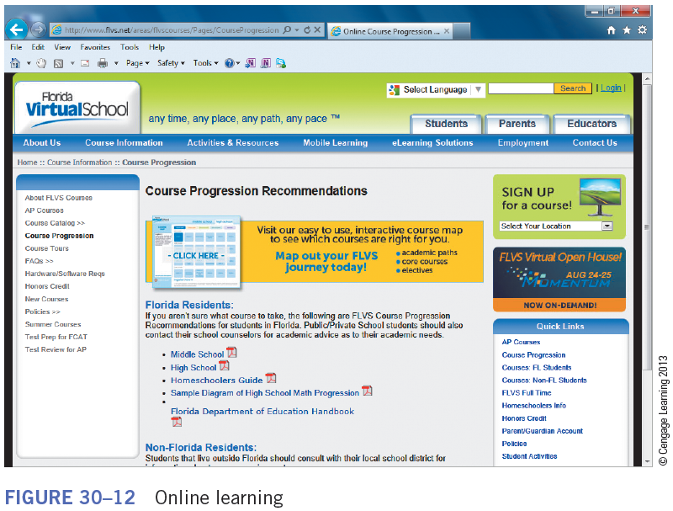
Using Technology to Transform Traditional Processes (continued)
Media:
Music, video, audio, pictures, text—all can be distributed online through e-mail, blogs, Web sites, and other types of Internet distribution channels.
Online Learning:
Online schools are open any time—night or day.
23
23

Slide 24
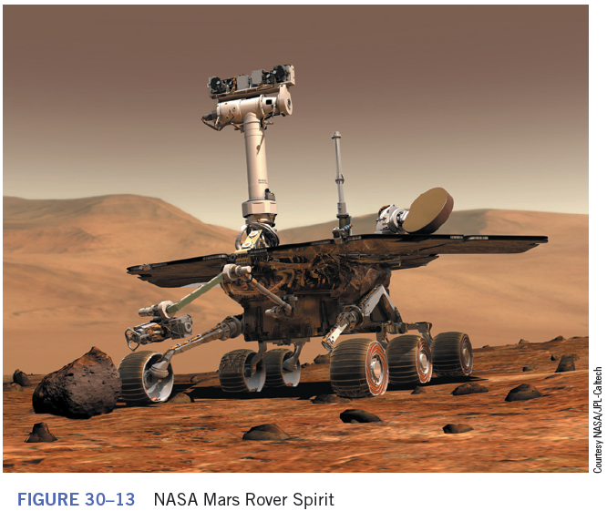
Using Technology to Transform Traditional Processes (continued)
Robotics:
Some specialized robots have been developed that do have a humanoid appearance. They allow exploration of hostile environments unsafe for humans.
24
24

Slide 25
Using Technology to Transform Traditional Processes (continued)
Telecommuting:
When employers allow their employees to work from home, this arrangement is called telecommuting. It involves using communications technology to keep the employee connected to the office.
Online Communities:
Online communities enable groups of people to interact online through a communications media rather than face-to-face.
25
25

Slide 26
Using Technology to Transform Traditional Processes (continued)
Disaster Recovery:
A segment of disaster recovery plans should include options for electronic communications, such as a Web site that is updated periodically, e-mail availability, and available resources and locations where help can be provided.
26
26

Slide 27
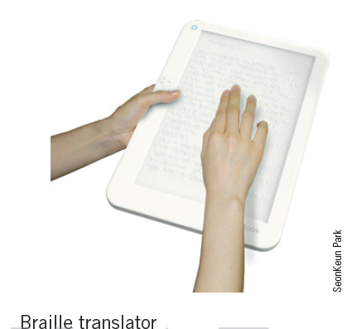
Identifying Assistive Technologies
Assistive Technologies for the Physically Challenged:
Electronic devices help disabled people communicate, become more mobile, and participate in activities.
Several adaptive software options are available for people with vision challenges.
27
27

Slide 28
Identifying Assistive Technologies (continued)
Electronic Learning:
E-learning and online courses are offered throughout the world by public and private education institutions.
The Federal government provides a number of free educational resources.
Local community centers and libraries provide free or inexpensive educational opportunities.
28
28

Slide 29
Identifying Assistive Technologies (continued)
Public Service:
Libraries often include Internet-connected computers for patrons to use to conduct online job searches, access government Web sites, or find general information.
Electronic Government:
All states and most cities have a Web site that provides information about the city or state.
29
29

Slide 30
Summary
In this lesson, you learned:
Computers are used in different areas of work, school, and home to collect, organize, evaluate, and communicate information; increase productivity, collaborate with others, and facilitate learning and daily life.
Desktop and laptop computers represent only a fraction of interaction with computer technology. Embedded computers in automobiles, appliances, and mechanical equipment, for example, are more prevalent. These computers are programmed to perform a specific task within the equipment.
30
30

Slide 31
Summary (continued)
Traditional processes for banking, news delivery, and education have been transformed due to e-commerce, online news content, and online learning.
Robotics and other automated systems have increased the efficiency of manufacturing and production.
31
31

Slide 32
Summary (continued)
Online communities provide communication links for people who share similar interests. They also bridge geographical boundaries between people. Online learning and other learning opportunities are available through the Internet.
New jobs and new job categories related to the Internet and electronic commerce are being developed. People can telecommute and collaborate globally using e-mail, networks, and automated systems.
32
32

Slide 33
Summary (continued)
Electronic communication is used to distribute disaster information.
Technologies such as voice recognition software are available for the blind.
Local, state, and national governments can provide access to information for the economically disadvantaged.
33
33

